Slide 1
Be a Computer Scientist for a Week presents:
Programming BoeBots with Arduino
(Part 2)
Juan Camilo Gamboa Higuera
School of Computer Science
McGill University
July 10th,2014

Slide 2
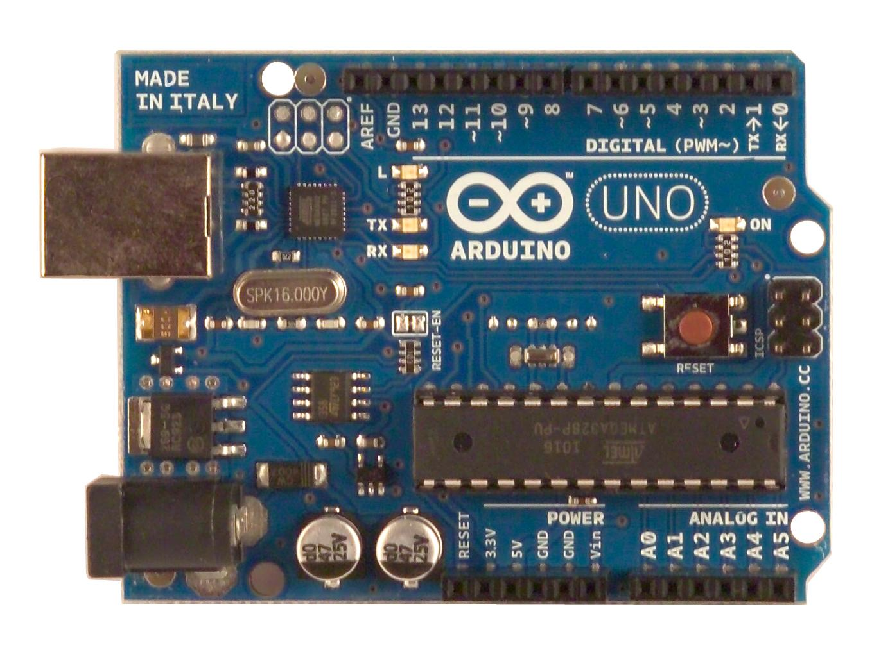
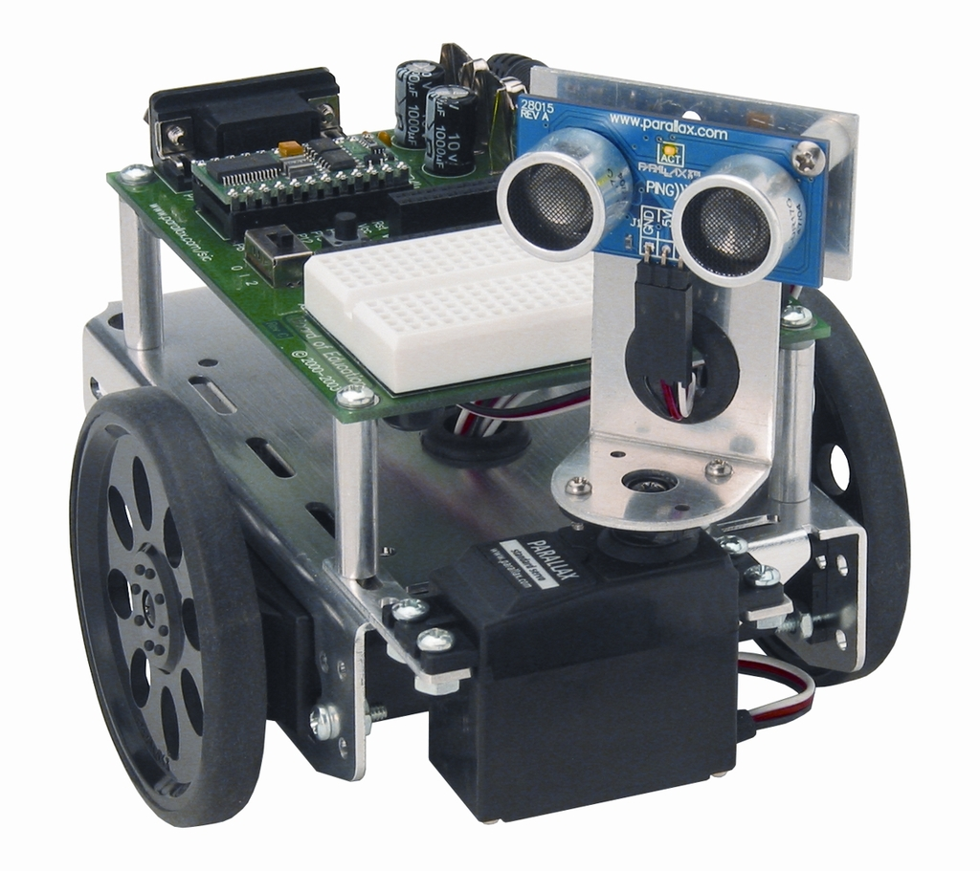
Yesterday’s new acquaintances
The body
The brain

Slide 3
What you learned yesterday
How to program the “brain” to control the “body”
The body
The brain

Slide 4
What you learned yesterday
Basic flow of the Arduino programs
majority of robots out there
// Declare global variables here
void setup(){ /* Initialize variables,
sensors and motors here */ } void loop(){
/* Get measurements from sensors,
update variable values,
and execute robot actions here */ }
Sense, plan and act!

Slide 5
What you learned yesterday
Using the BoeBot’s sonar sensor
Moving the BoeBot’s head to detect obstacles
Moving the BoeBot by changing the speed of the wheels

Slide 6
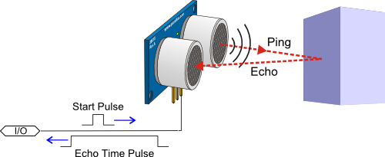
Sensing with the BoeBot

Slide 7
Sensing with the BoeBot
int sonar_pin = 11; long read_sonar(){ long duration, range_cm; pinMode(sonar_pin, OUTPUT); digitalWrite(sonar_pin, LOW); delayMicroseconds(2); digitalWrite(sonar_pin, HIGH); delayMicroseconds(5); digitalWrite(sonar_pin, LOW); pinMode(sonar_pin, INPUT); duration = pulseIn(sonar_pin,HIGH,20000); range_cm = (duration/29)/2; return range_cm; }
Send Pulse
Wait for echo
Convert to cm

Slide 8
Sensing with the BoeBot
void setup() { Serial.begin(9600); }
void loop() { // use the function we just wrote long range_cm = read_sonar(); Serial.print(range_cm); Serial.print("cm"); Serial.println(); delay(100); }

Slide 9
Checking out what’s around the Boebot
Turning this guy’s head

Slide 10
Checking out what’s around the Boebot
#include <Servo.h> int sonar_servo_pin = 10; int sonar_pin = 11; int sonar_angle = 45; int angle_increment = 10; void sonar_sweep_step(){ sonar_angle = sonar_angle + angle_increment;
if (sonar_angle >= max_angle ||
sonar_angle <= min_angle ){ angle_increment = -angle_increment; }
sonar_servo.write(sonar_angle); delay(20); }
Declare global variables
Change turning direction

Slide 11
Checking out what’s around the Boebot
void setup() { Serial.begin(9600); sonar_servo.attach(sonar_servo_pin); }
void loop(){ // sense long range_cm = read_sonar();
// turn the robot’s head by a single step sonar_sweep_step(); Serial.print(sonar_angle); Serial.print("degrees,"); Serial.print(range_cm); Serial.print("cm"); Serial.println(); }

Slide 12
Moving the BoeBot
Setting the speed of these

Slide 13
Moving the BoeBot
#include <Servo.h> int sonar_servo_pin = 10; int left_servo_pin = 9; int right_servo_pin = 8; Servo sonar_servo; Servo left_wheel; Servo right_wheel; int max_speed_left = 500; int speed_offset_left = 1500; int max_speed_right = 500; int speed_offset_right = 1500;
Declare global variables
Calibration of motors

Slide 14
Moving the Boebot
void set_speed_left(float sp){
int new_speed = int(sp*max_speed_left + speed_offset_left); left_wheel.write(new_speed);
} void set_speed_right(float sp){
int new_speed = int(sp*max_speed_right + speed_offset_right); right_wheel.write(new_speed);
}
Set motor speed
sp = 0.0 motor stops
sp = 1.0 maximum speed

Slide 15
Moving the BoeBot
void move_forward(float sp){ set_speed_right(-sp); set_speed_left(sp); }
void turn_right(float deg, float sp){ set_speed_right(sp); set_speed_left(sp);
float angular_speed = sp*0.138; delay(deg/angular_speed);
set_speed_right(0); set_speed_left(0); }
Turn
Wait
Stop

Slide 16
Moving on!
How can we test the abilities of our robots?

Slide 17
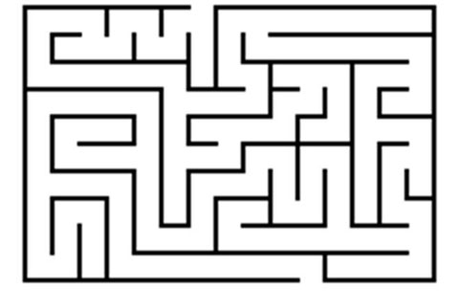
Navigating a Maze
How hard is it to solve?
Do our robots have what it takes?

Slide 18
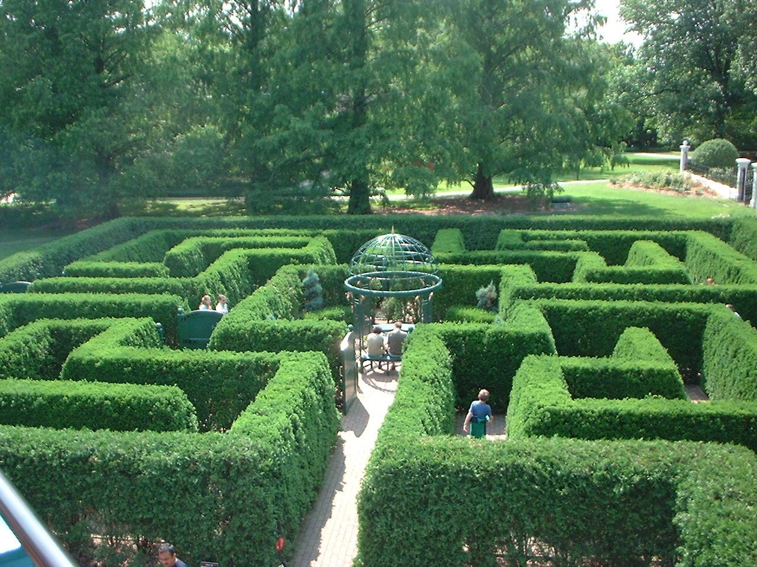
Navigating a Maze
What strategies do people use?

Slide 19

Navigating a Maze
What strategies do people use?
How can a robot do the same ? (or better, actually)

Slide 20
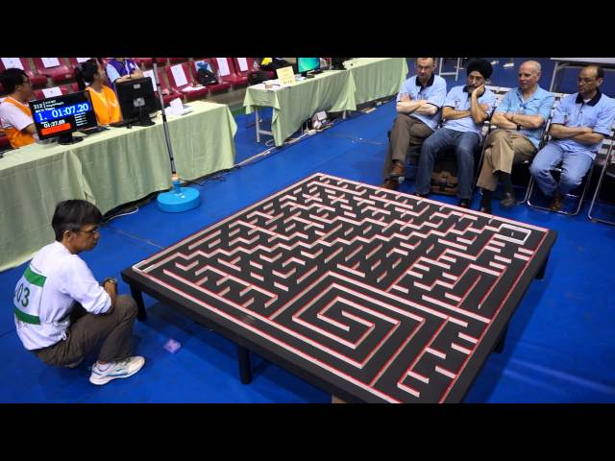
Navigating a Maze
What strategies do people use?
How can a robot do the same ? (or better, actually)

Slide 21
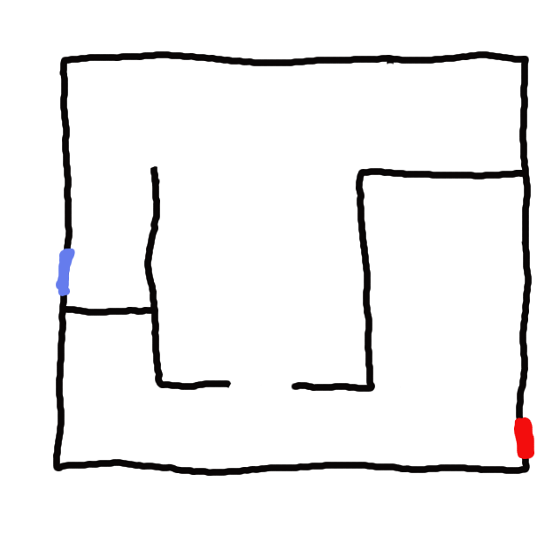
A simple idea in a simple maze
GOAL
START
Check every possible path. Backtrack if dead end.

Slide 22
A simple idea in a simple maze
GOAL
START
Check every possible path. Backtrack if dead end.
Same result: Just follow the right wall (or the left wall)

Slide 23
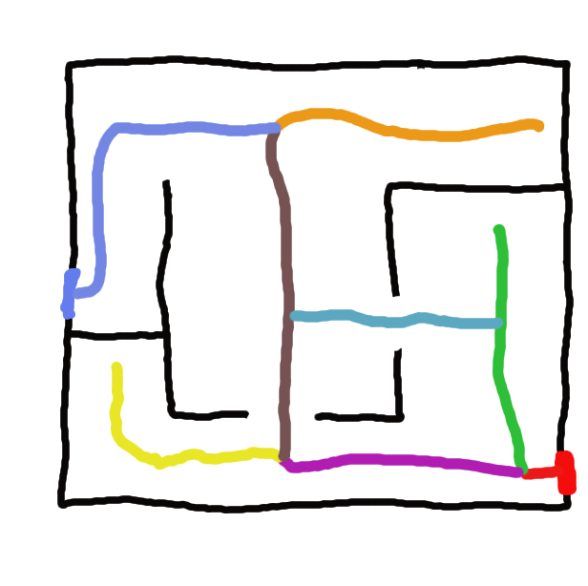
A simple idea in a simple maze
GOAL
START
Also works if the maze has loops
Just follow the right wall (or the left wall)

Slide 24
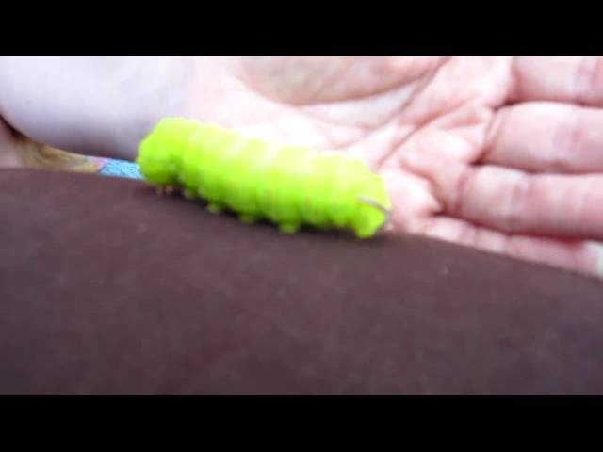
Solving the maze with the BoeBot
A hint from nature

Slide 25
Solving the maze with the BoeBot
Need to stay close to the wall...
But move away if too close to it

Slide 26
What happens if the maze is disconnected?
START
GOAL
Wall following might bring you close...
And then back to the beginning

Slide 27
Some useful tips
Try drawing the flow behaviours of your robot
Obstacle too close
Robot Moving forward with high speed
Robot not moving forward or backwards
Imagine what are the possible states of the robot
Try to describe what makes the state change
Obstacle too far
Robot is not moving
Turned 5 degrees
Keep it simple!
Robot turning to the right
Robot turning to the left
Obstacle is now on the right side of the robot

Slide 28
Some useful tips
Use global variables for robot’s state
// Declare global variables here
void setup(){ /* Initialize variables,
sensors and motors here */ } void loop(){
/* Get measurements from sensors,
update global variables,
and execute robot actions here */ }

Slide 29
Additional Tips
Use functions!
Don’t copy and paste the same code multiple times
keep the loop simple!
Use comments!
So you and your team-mates understand the code
The loop function is executed periodically
As fast as the Arduino can execute your code
You can use this to do things in parallel
Explore the documentation and examples: arduino.cc

Slide 30
Programming BoeBots with Arduino
(Part 2)
Any questions?

